Slide 1
Andrea Ippolito
Executive Director
Engineering Management Program
aki2@cornell.edu

Slide 2
Cornell University
"I would found an institution where any person can find instruction in any study”
- Ezra Cornell
Notes:
Founded in 1865

Slide 3
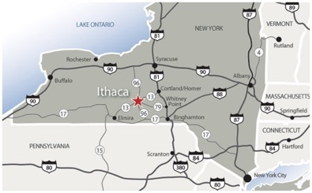
Why Ithaca, NY?
10 Cheapest Urban Cities for TwentySomethings, February, 2015
Ithaca ranked among the 20 Best College Towns for Food in America, April 2015
Ithaca named 9th Most Exciting College Towns by MSN Real Estate, May 2014
Ithaca named among best small cities for young single women, March 2015
The Finger Lakes ranked 8th must-visit spot on the "Wine Tours of the World" feature from ABC News, April 2014
Tompkins County named 2nd "Healthiest County in New York" by CountyHealthRankings.org, April 2014
Ithaca named one of "America's Most Romantic Towns" by Travel + Leisure, January 2014

Slide 4
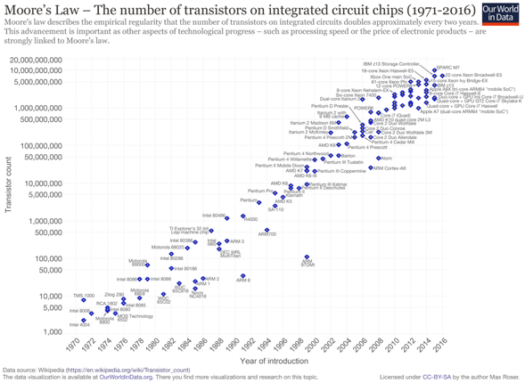
The pace of technological change is moving quickly…
Notes:
Moore's law is the observation that the number of transistors in a dense integrated circuit doubles approximately every two years.

Slide 5
…and technology is touching our lives almost every moment of every day.
Chartwell, 2017

Slide 6
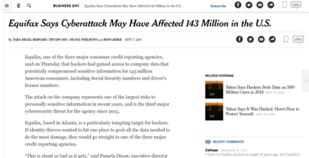
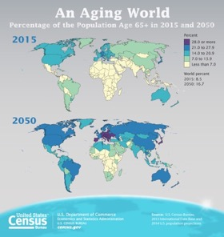
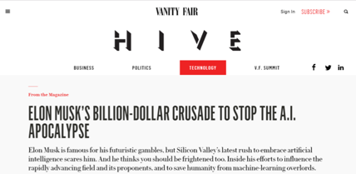
More than ever, we need strong engineering leaders to tackle the most pressing challenges
Nasa.gov
Notes:
http://www.engineeringchallenges.org/challenges.aspx

Slide 7
What is engineering management?
Engineering
Management
Engineering Management
The Engineering Management program at Cornell is geared towards engineers who want to stay in a technological environment, but focus on managerial roles.

Slide 8
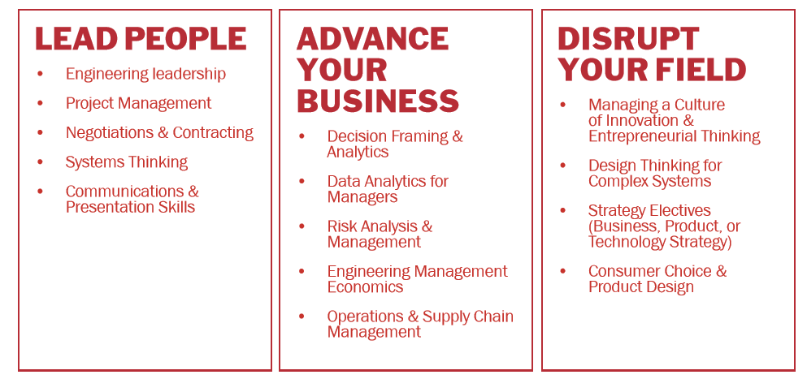
Core areas of the degree

Slide 9
Cornell Engineering Management Master of Engineering Program One of the oldest, most reputable programs in the country

Slide 10
Why Cornell’s Engineering Management M.Eng. Program?
Access to world-class engineering and business programs
Flexibility
Partnerships with industry
Amplify your problem-solving skills
94% job placement rate within 3 months of graduation
Join a vast alumni network and community
230,000+ Cornell alumni
Notes:
Semester in Strategic Operations

Slide 11
Five most common career paths after graduation
Consulting and Finance
Example companies: Goldman Sachs, Accenture, Deloitte
Data Analyst/Business Analyst
Tech: Product Manager, Entrepreneur
Example companies: Wayfair, Intel, Microsoft
Engineering Leadership Development/Rotational Program
Example companies: Northrop Grumman, GE
Example companies: DIA Associates, Capitol One, ZS Associates
Real Estate and Construction Management
Example: Skanska, Clark Construction

Slide 12
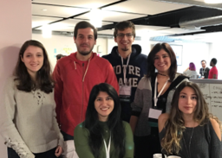
Who attends the program?
Average age of students: 24-25
33% female
Broad engineering backgrounds: Mechanical, Computer Science, Electrical, Industrial, Civil and Environmental, Biomedical, Chemical, etc.
Social participants
Club participants
Hackathon winners

Slide 13
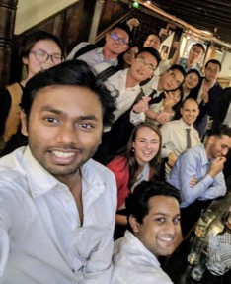
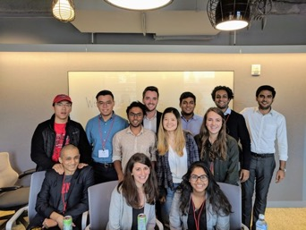
Who attends? People looking to be part of a cohort!

Slide 14
Cornell is a member of the Master of Engineering Management Program Consortium

Slide 15
Program Structure
Fall courses
Winter break
Spring courses
+ Optional summer internship and optional 3rd semester
Coursework and project-oriented program
30 credit hours + two, 1-credit seminar course
Can be completed in 2 semesters or 3 semesters for students wanting more electives or internships

Slide 16
Core Curriculum
Required Core Courses
Project Management
Engineering Management Methods/Data Analytics
1 course in Finance or Accounting
Economics and Finance for Engineering Managers
1 course in Organizational Behavior
Entrepreneurship and Private Equity
Engineering Management Project
Introduction to Decision Analysis
Marketing Management
Managerial Decision Making
Mgmt. and Leading in Organizations
Project Management and Professional and Leadership Development Seminars
Managing a Culture of Innovation
+ 3 specialization electives

Slide 17
Specialization electives*
“Build your own” track
Consulting
Analytics
Entrepreneurship and Product Manager
Real Estate and Construction Management
Engineering Leadership
Sustainability and Renewable Energy
*You are welcome to mix and match courses from different headings, choose courses aligned with your own interests, or develop your own specialization to best serve your professional goals.

Slide 18
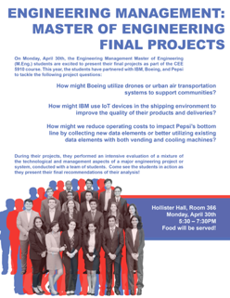
Engineering Management culminating team project course
As a “capstone” for your M.Eng. experience, you will work on a team to perform an intensive evaluation of some mixture of technological and management aspects of a major engineering project or system
Sample topics:
Sales and marketing
Cost and life cycle benefits
Forecasting
Technology roadmapping or selection
Triple bottom line evaluations
Decision analysis and support
Manufacturing
Information exchange

Slide 19
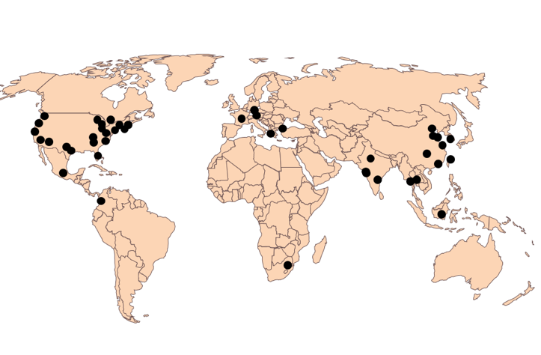
Where do Engineering Management students go after graduation?
Sampling of location of graduates from past 5 years

Slide 20
Career Services and Support
Cornell Career Services attracts top companies from across the world to participate in on-campus recruiting.
Career placement stats:
Sample job titles:
Consultant
Product Manager
Technical Lead
Start-up leadership
Project Engineer
Program Manager
Strategy Analyst
Business Manager
94% students placed within 3 months of graduation
Median
$74,375
High:
$130,000+

Slide 21
Career Services and Support
Cornell Career Services attracts top companies from across the world to participate in on-campus recruiting.
Sample companies:
Accenture, Johnson & Johnson, Goldman Sachs, JP Morgan Chase, Capitol One, Pricewaterhouse Coopers, Oracle, Black and Veatch, Citigroup, Blackrock, Kimberly-Clark, Hitachi USA, Canon USA, DropBox, McKinsey, Skanska, Intel, Amazon, Ernst + Young, WorkDay, Northrop-Grumman, IHI Machinery, SunPower, Skanska, Corning

Slide 22
ENMGT 6090: Professional and Leadership Development Series
July
August
September
October
November
c
c
c
c
Career Services Kickoff Webinar
Meet 1:1 with faculty to review resumes, cover letter, and career development plan
Orientation workshops, including career services, cohort building activities, and leadership development
Meet with faculty advisory to review program and career goals
Career fair
Informational interview and mock interview prep
Company visits to campus and information sessions
NYC Trek to companies
Company visits to campus and information sessions
c
Personal branding plan
Leadership development

Slide 23
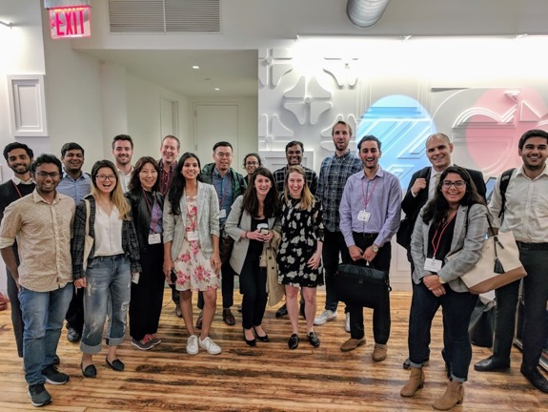
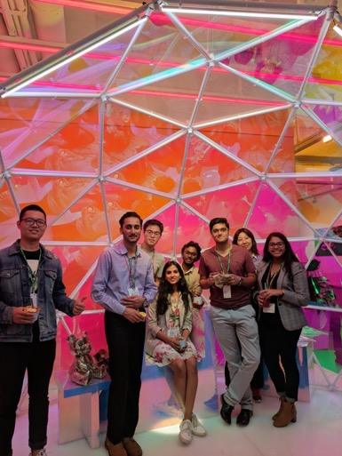
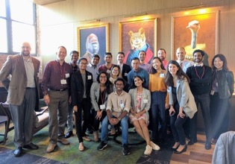
Career Trek to NYC
We make an annual trip to NYC to tour alumni companies to network for job opportunities
This year, we met with Google, Facebook, Goldman Sachs, McKinsey, Lyft, and WSP

Slide 24
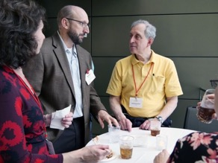
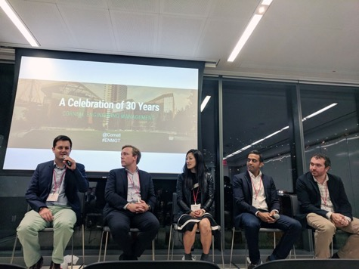
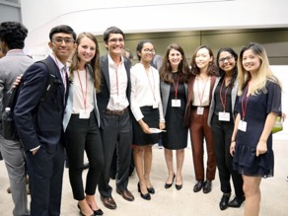
Alumni Events

Slide 25
Entrepreneurship @ Cornell
Accelerator / incubators across campus
Start-up internship programs
Mentorship forums
Funding opportunities
Entrepreneurship courses
Business plan and venture competitions
Large scale events and summits

Slide 26
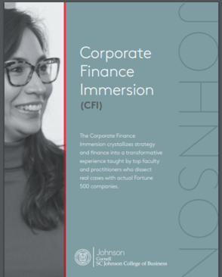
Immersion Programs at Johnson College of Business for MEM students

Slide 27
Tuition and Scholarships
The semester tuition for M.Eng. students is $26,306
Scholarships and Financial Aid
Cornell Engineering provides merit-based fellowships, partial scholarships or teaching assistantships to around 30% of M.Eng. students.
College of Engineering Special Awards, including the Lester B. Knight Scholarship of $40,000, are available to highly qualified students who intend to pursue both an M.Eng. and M.B.A. at Cornell University.

Slide 28
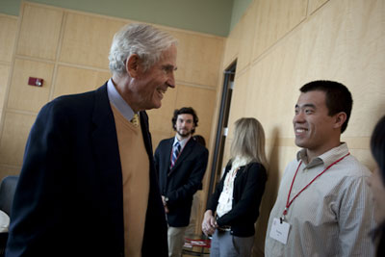
Lester B. Knight M.Eng./MBA Scholarship
Award Amount: $40,000 ($20,000 for M.Eng. and $20,000 for MBA)
Application Process:
Application deadline: February 1st
To be considered, students need to complete an online application for admission, write a 500-word essay and submit a one-page resume.
The essay should describe experiences that motivated you to pursue engineering and business, student's interests and achievements, and his/her future career goals.

Slide 29
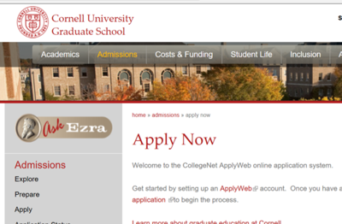
Application details
The application deadline for Cornell's M.Eng. in Engineering Management Program is January 5, 2019.
Application requirements include:
Online application
Statement of purpose
Transcripts
Letters of recommendation (3)
Application fee
GRE scores
TOEFL scores for applicants whose native language is not English
We will also interview a select group of students prior to admission to the program.

Slide 30
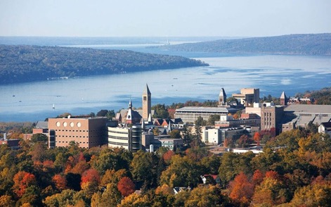
Some application tips!
The application deadline for Cornell's M.Eng. in Engineering Management Program is January 5, 2019.
Be creative! We want to learn more about you in a fun, engaging way.
Highlight your strengths: This is the time to showcase you and how you will contribute to the Cornell Engineering Management community.
Share your passion for Cornell: We are excited to hear what gets you excited about Cornell and the MEM program.

Slide 31
Additional Program Offering: M.Eng./MBA Program
Benefits:
Blend and deepen your knowledge and training in both disciplines from two, top ranked programs
Expand and diversify your professional and personal network
Leverage leadership training and team-based learning
Earn both degrees within a condensed timeframe
Boost your market and professional value

Slide 32
M.Eng./MBA (2 Year Option)
Year 1: M.Eng.
Year 2: MBA
Fall/Spring
May
July
Fall/Spring
CURRICULUM
Core Disciplinary Coursework
Concentration Electives
Complementary Electives
Projects
Seminars
CAREER & Co-CURRICULAR
Summer Career Curriculum
Job Search Bootcamp
Professional Development
Project and Case Competitions
Professional career prep
Leading Teams
Data Analytics & Modeling
Finance
Strategy
Critical & Strategic Thinking
CORE
Principled Leadership
Operations
ELECTIVES
Deeper Coursework
Optional Concentrations
Cornell-wide courses
Cornell Tech Intensives
Performance Learning: Cayuga Fund, Venture Fund, Tech Strategy
Global Experience – Trip Courses
CAREER & Co-CURRICULAR
Full Time Job Search
Case Competitions
School & Community Service
June
July/August
Accounting
Economics
Marketing
Professional career prep for interviews
Short elective “bootcamps” incl. Oral Communication, Management Cases

Slide 33
Questions?
Andrea Ippolito
Executive Director
Engineering Management Program
aki2@cornell.edu

Slide 34
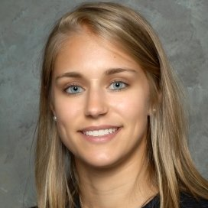
Recent Alumni Spotlight, Samantha Ebner
Cornell Engineering Management M.Eng. ’16
Current role:
Professional Development Leadership Program, Northrop Grumman
Prior to Cornell:
Mechanical Engineer at Amec Foster Wheeler
UNH

Slide 35
Average admissions statistics for our incoming class
GRE: 160 (verbal); 165 (quantitative); 4 (analytic)
GPA: 3.6
TOEFL: 28 (reading); 27 (writing); 29 (listening); 25 (speaking)

Slide 36
Cornell Exceptions
Cornell undergrad students do not need to take the GRE (or TOEFL)
You can leave the GRE section blank
You only need to submit 2 letters of recommendation, not 3

Slide 37
TOEFL exceptions
The English language proficiency requirement may be waived if the applicant meets at least one of these criteria:
is a citizen or permanent resident of the United States, or a citizen of the United Kingdom, Ireland, Australia, New Zealand or Canada (except Quebec). Applicants who are citizens of India, Pakistan, the Philippines, Hong Kong, Singapore, etc. are not exempt from the requirement.
at the time you enroll at Cornell, you will have studied in full-time status for at least two academic years within the last five years in the United States, the United Kingdom, Ireland, Australia, or New Zealand, or with English language instruction in Canada or South Africa. Even if English was the language of instruction at your school, if you did not study in one of these countries you are not exempt from the requirement. You must submit a transcript that shows you attended college in one of the approved locations, and that your academic program was at least two years in length.

